Slide 1

Global YouTube Statistics
Ryan
Kaisser
Rafi
Jaspreet

Slide 2
Our research statement
Looking at the top 1000 channels on YouTube to date, what contributes to a successful channel?
We aim to investigate what factors have contributed to the growth and popularity of channels globally and within their own countries

Slide 3
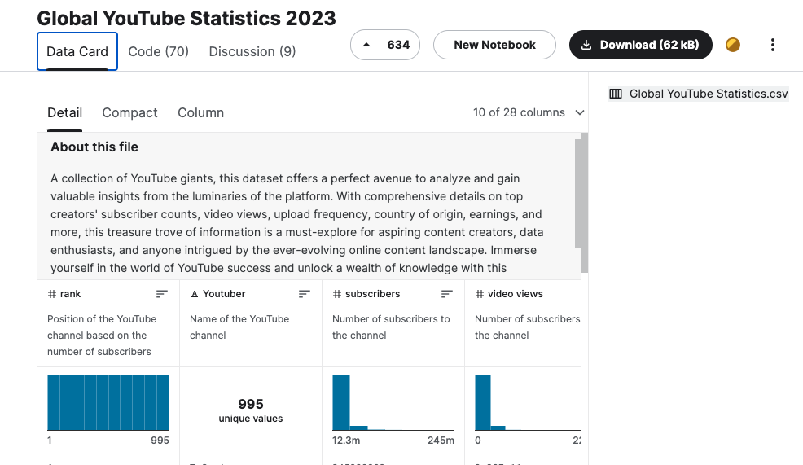
Where have we got our data from?
This data set was extracted from Kaggle, an online data sharing platform for Data Scientists and machine learning enthusiasts

Slide 4
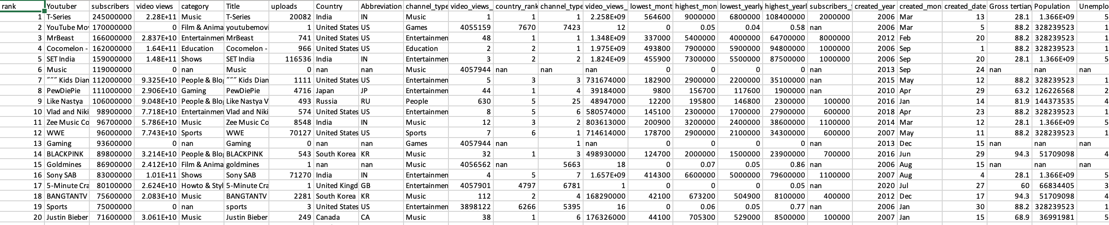
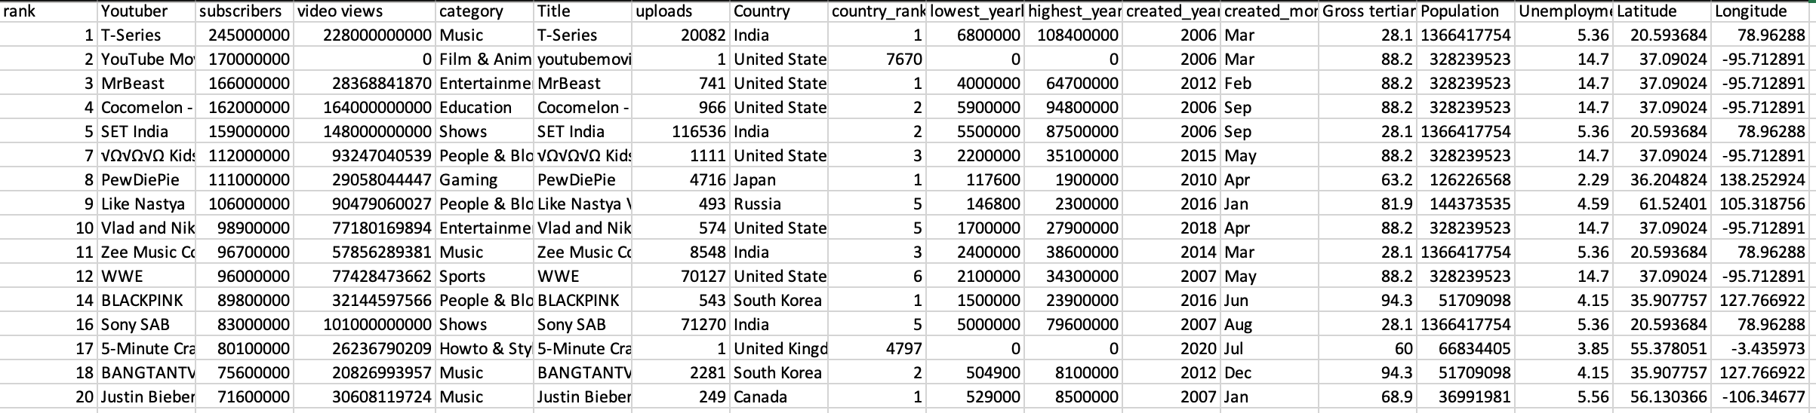

Cleaning raw data
We decided to omit columns that were not necessary for our analysis
NaN values were dropped
Scientific values were converted to integers

Slide 5

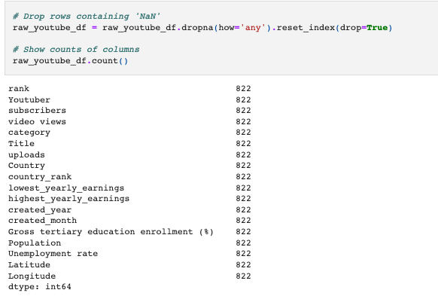
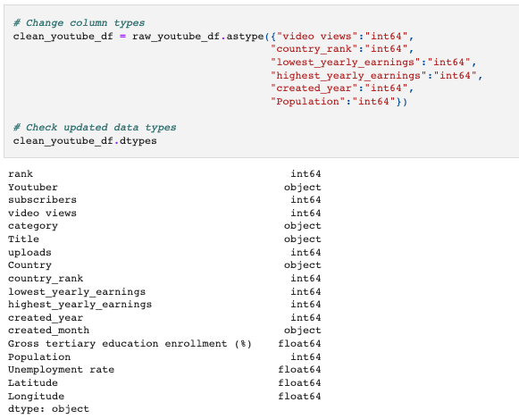
A brief outline on how we finalised our dataset before analysis

Slide 6
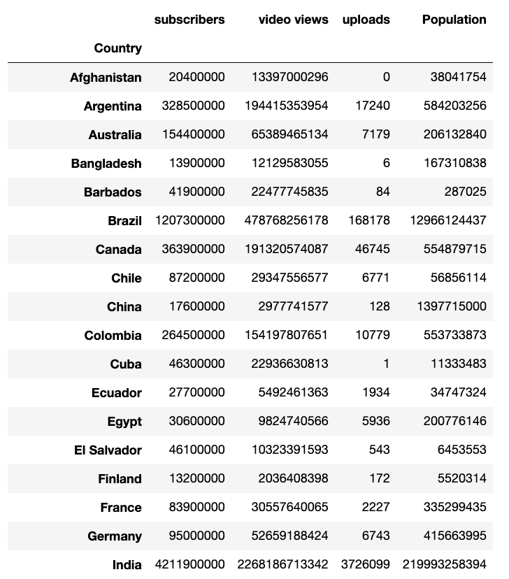
Which country has the most video uploads per capita?
In this section we analysed which country has the most uploads per capita. Using a sample size of 1000 people from 48 countries in the data set, we can gather that Singapore has the most video uploads.
Firstly, we had to create a separate data frame showcasing the columns needed for this section

Slide 7
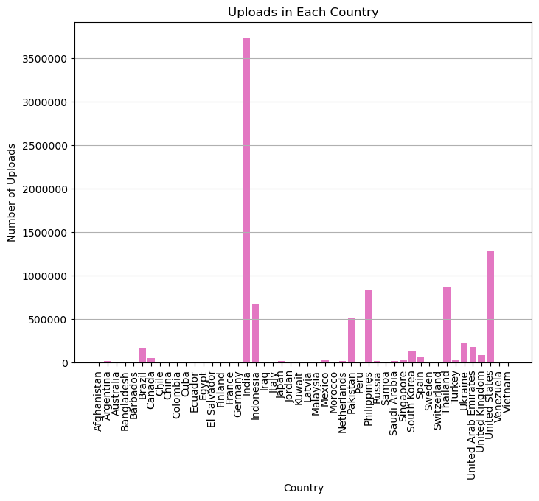
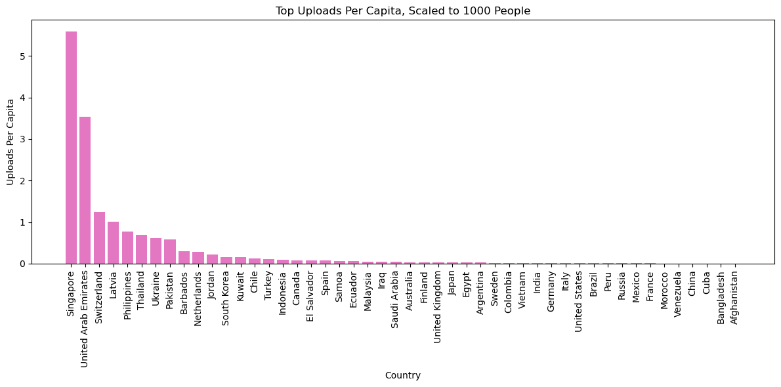
This dataset offers valuable insights into the YouTube landscape across various countries, from top-ranking nations to those with the most video uploads per capita. Further analysis can provide additional insights and trends within this data

Slide 8
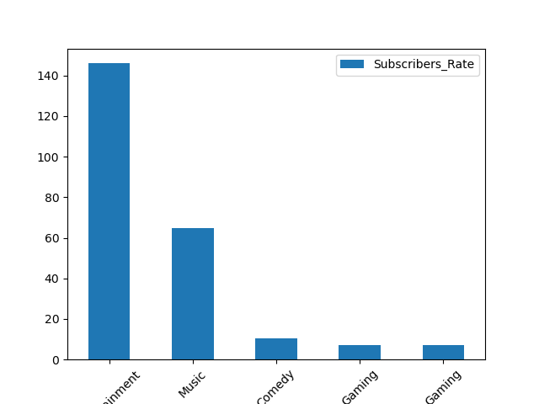
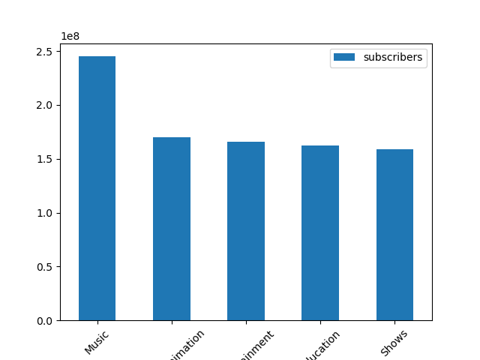
Which category is the most popular as a whole, and in each country?

Slide 9
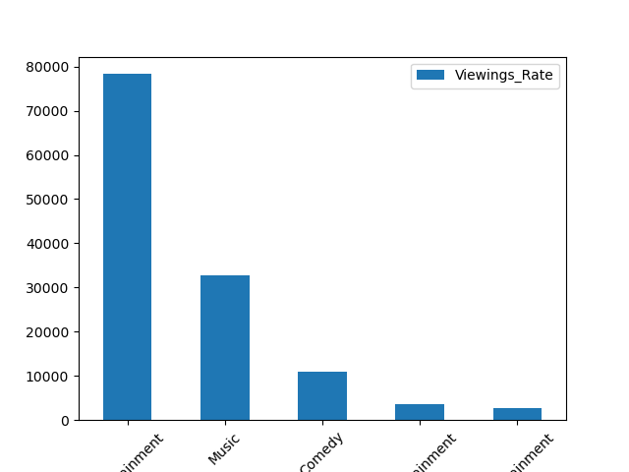
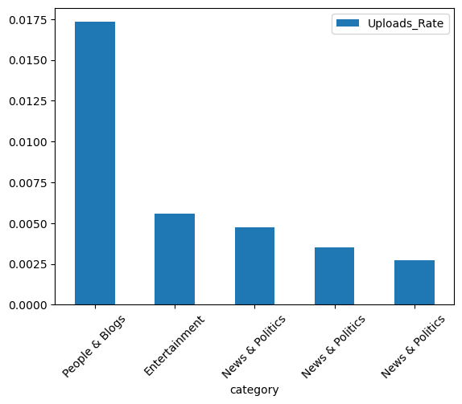

Slide 10
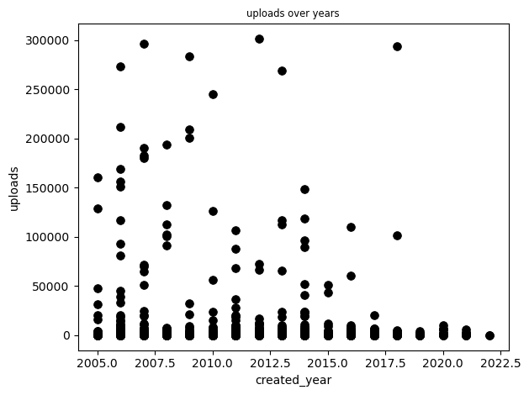
Comparison over years for number of uploads globally

Slide 11
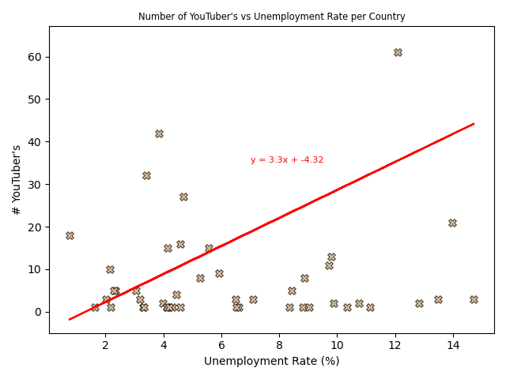
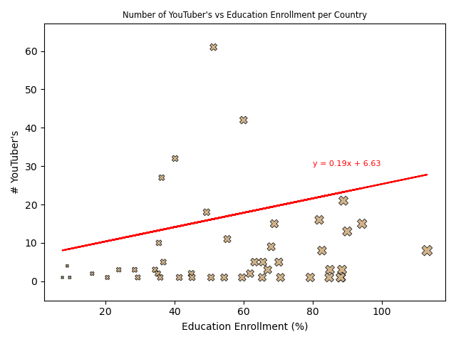
Does the % of population in education have a positive/negative correlation with the number of successful YouTube channels per country?

Slide 12

Evaluation
If we were to repeat this exercise again there are many areas we could expand on. For example, we could make use of YouTube and Google APIs to obtain more dynamic data.
We could also produce map plots using the latitude and longitude values in the dataset, creating a better visual of country specific data.
Considering the vastness of the YouTube platform we could potentially use a larger data set focused on the countries that are the biggest users and consumers

